Slide 1
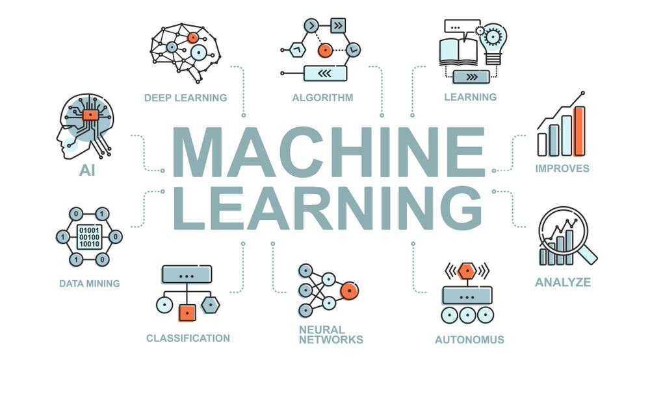
Linear Regression

Slide 2
Introduction to Machine Learning

Slide 3

Introduction to Machine Learning
Machine learning automates tasks without explicit programming.
It involves learning patterns from data to make decisions.
Data sets are used to train models for prediction accuracy.
Machine learning mimics human learning processes iteratively.
Machine learning impacts society in various domains and applications.
Examples include recommendation systems, loan approval predictions, and customer segmentation.

Slide 4
Machine Learning Techniques
Regression/Estimation predicts continuous values like house prices.
Classification predicts categories like benign or malignant cells.
Clustering groups similar cases for segmentation or patient analysis.

Slide 5
Python for Machine Learning
Python is a powerful programming language for data science.
NumPy is a math library for efficient computation with arrays.
SciPy offers numerical algorithms and domain-specific tools.
Matplotlib provides 2D and 3D plotting capabilities.
Pandas simplifies data manipulation and analysis with high-level structures.
Learning these packages is essential for data scientists tackling real-world problems.

Slide 6

SciKit Learn for Machine Learning
SciKit Learn is a free ML library for Python, popular among data scientists.
It includes classification, regression, and clustering algorithms.
The library works seamlessly with NumPy and SciPy.
SciKit Learn streamlines the ML pipeline from preprocessing to model evaluation.
It offers easy implementation of machine learning models with minimal code.
Using SciKit Learn, tasks like data standardization, model training, and evaluation are simplified.

Slide 7
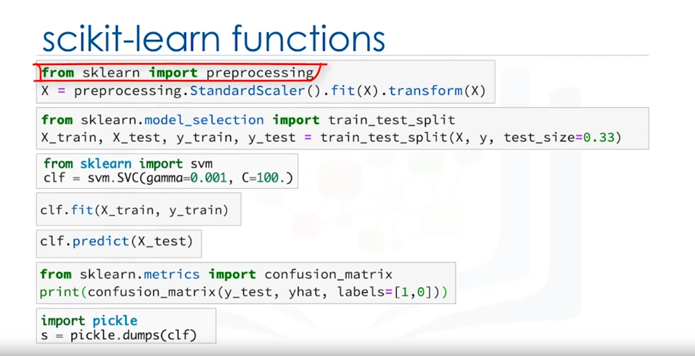

Slide 8
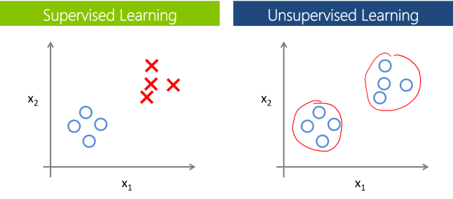
Supervised vs Unsupervised

Slide 9

Supervised Learning
Definition of Supervised Learning
Involves observing and directing a machine learning model.
Utilizes labeled data to teach the model.
Types of Supervised Learning Techniques
Classification: Predicting discrete class labels or categories.
Regression: Predicting continuous values.

Slide 10
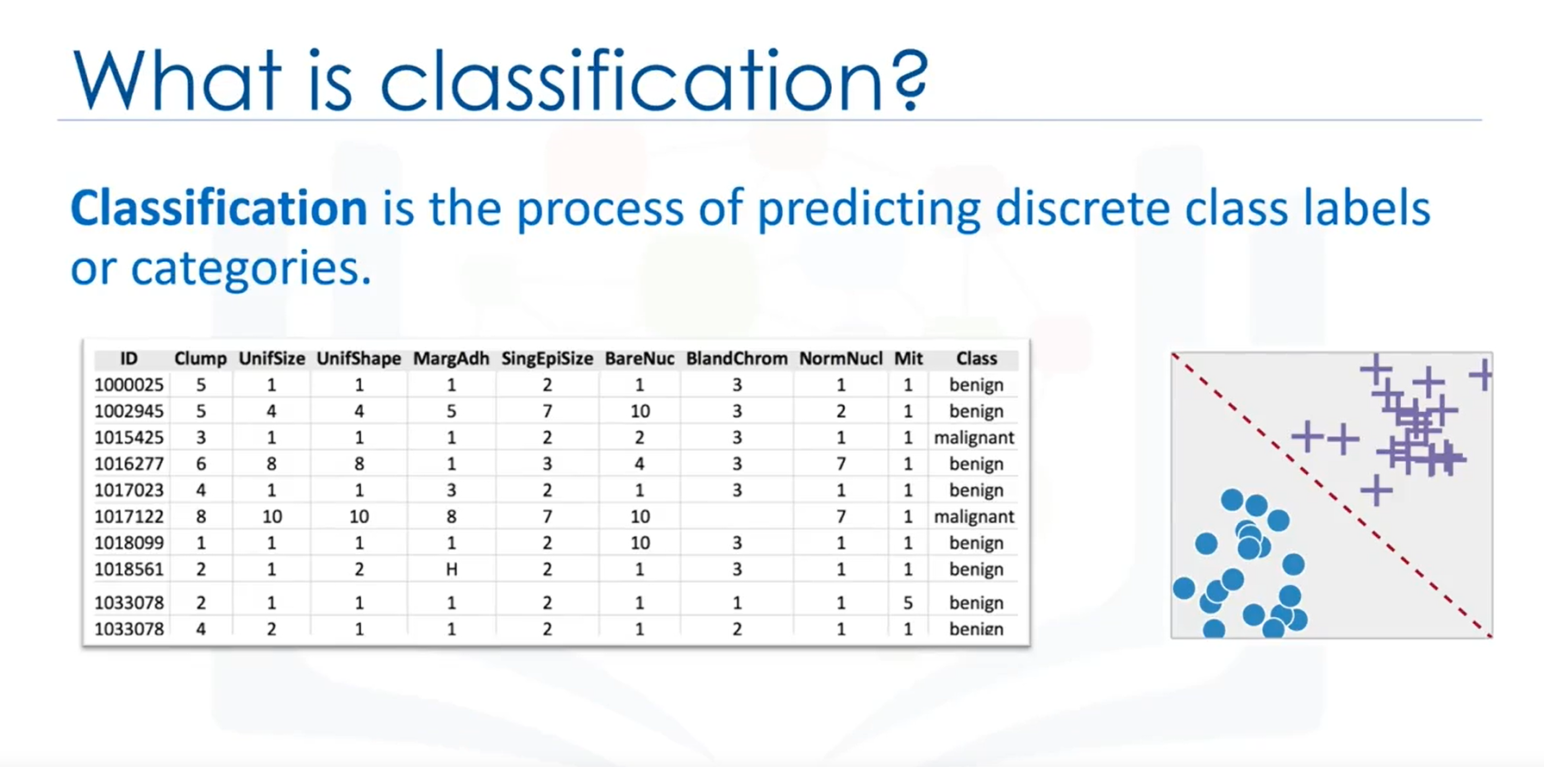

Slide 11
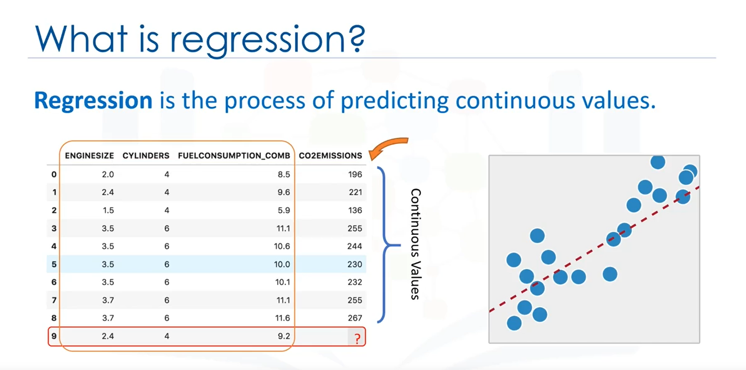

Slide 12
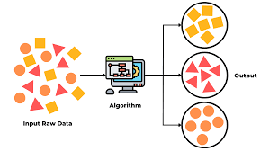
Unsupervised Learning
Definition of Unsupervised Learning
Model works independently to discover hidden information.
Trains on unlabeled data and draws conclusions.
Unsupervised Learning Techniques
Dimension reduction and feature selection.
Market basket analysis, density estimation, and clustering.
Applications of Clustering
Segmentation in banking based on customer characteristics.
Grouping music preferences for personalized recommendations.

Slide 13
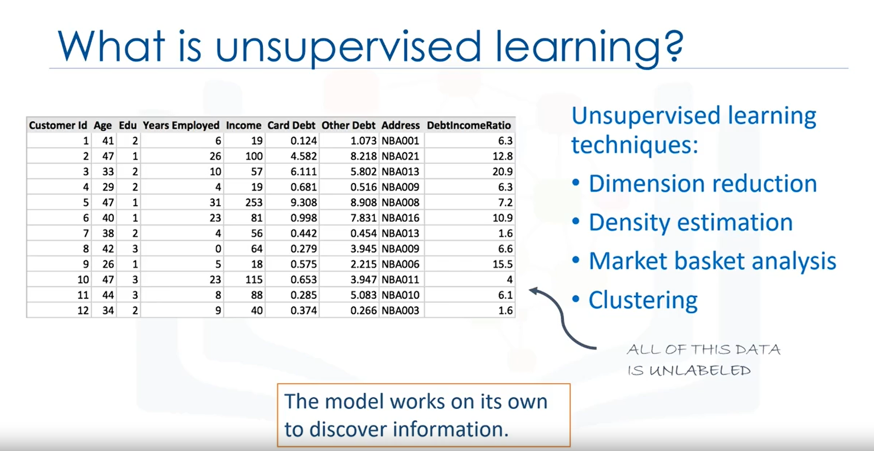

Slide 14


Slide 15



Comparison and Summary
Key Differences Between Supervised and Unsupervised Learning
Evaluation and Controllability
Conclusion
Supervised deals with labeled data; unsupervised with unlabeled.
Supervised includes classification and regression; unsupervised includes clustering.
Supervised learning has more models and evaluation methods.
Unsupervised learning creates a less controllable environment.
Both approaches are essential in machine learning for different tasks.
Understanding their differences and applications is crucial in data science.

Slide 16
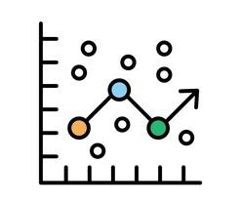
Regression

Slide 17



Introduction to Regression
Regression Overview
Types of Regression
Regression Applications
Predicting continuous values like CO2 emissions.
Using historical data and regression methods.
Simple regression with one independent variable.
Multiple regression with multiple independent variables.
Sales forecasting based on age, education, experience.
Psychology for individual satisfaction predictions.
Housing price prediction using size and bedrooms.

Slide 18
Simple Linear Regression
Regression

Slide 19
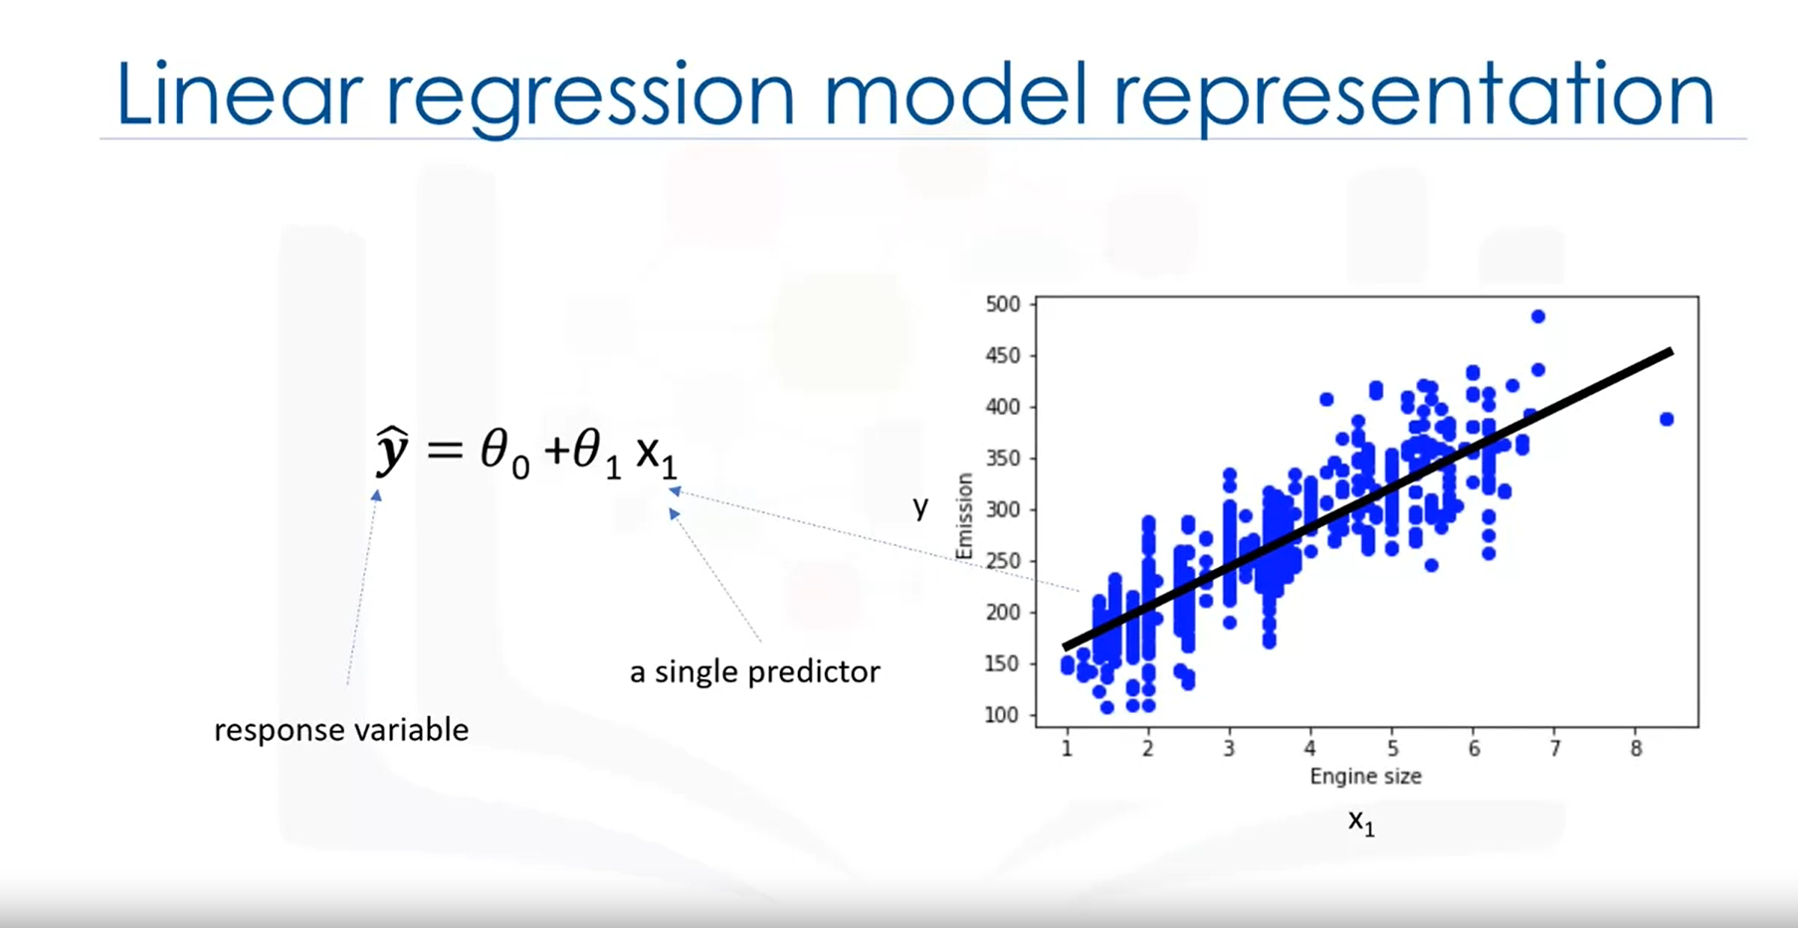

Slide 20
Working Principles of Linear Regression
Fitting the Regression Line
Plotting variables to understand their relationship.
Fitting a line through data points for prediction.
Model Parameters
Theta 0 and Theta 1 as intercept and slope.
Calculating coefficients for best-fit line.
Minimizing Errors
Mean Squared Error (MSE) for model accuracy.
Objective: Minimize error for accurate predictions.

Slide 21
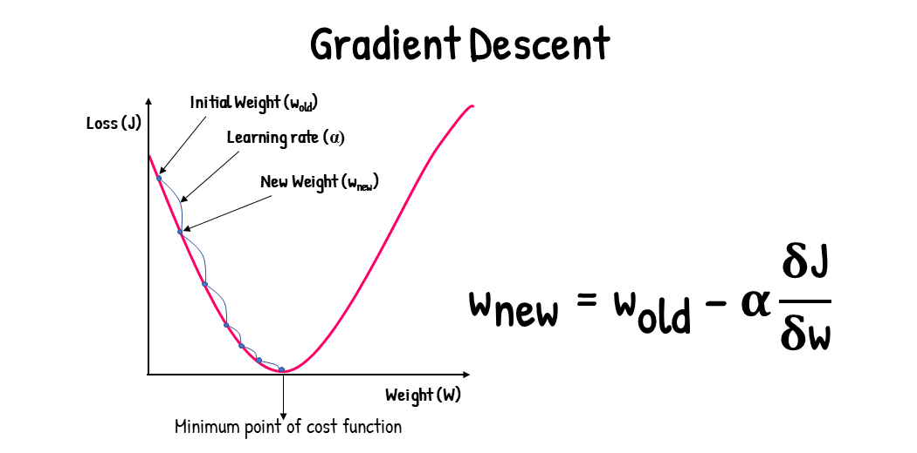

Slide 22
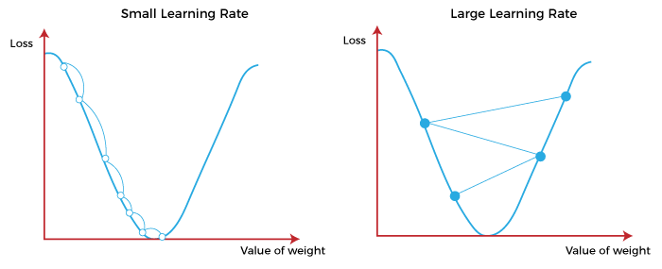

Slide 23
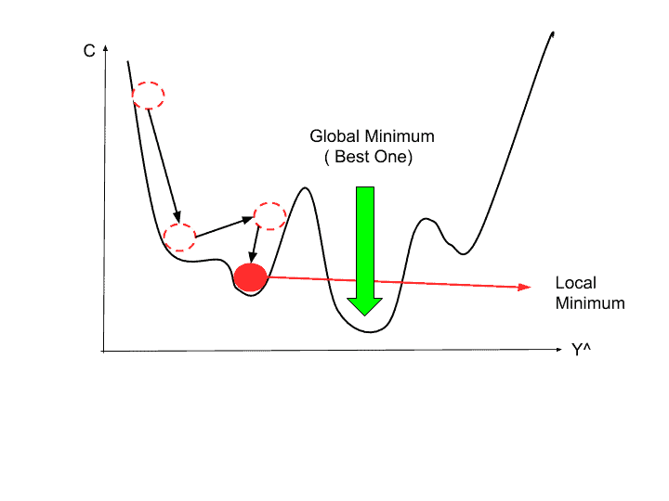

Slide 24
Model Evaluation in Regression Models
Regression

Slide 25
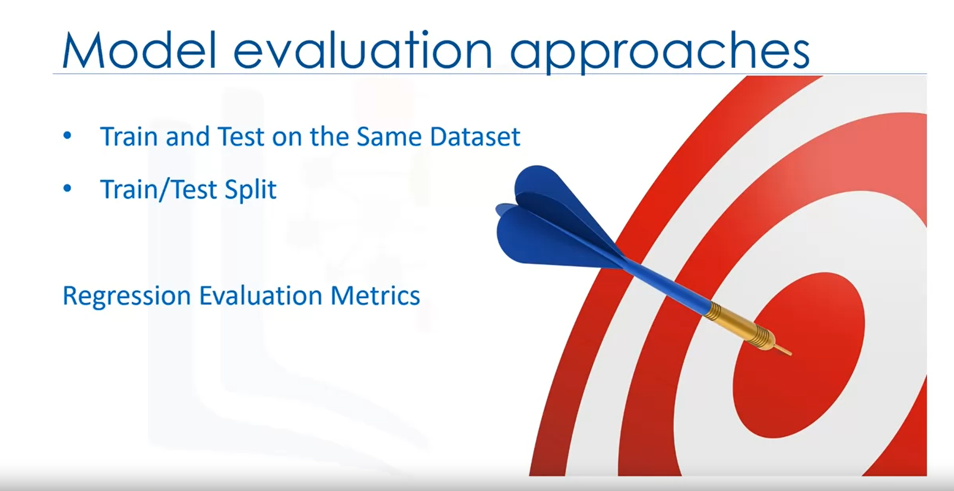

Slide 26
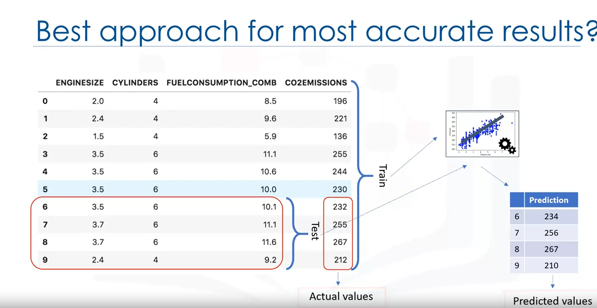

Slide 27
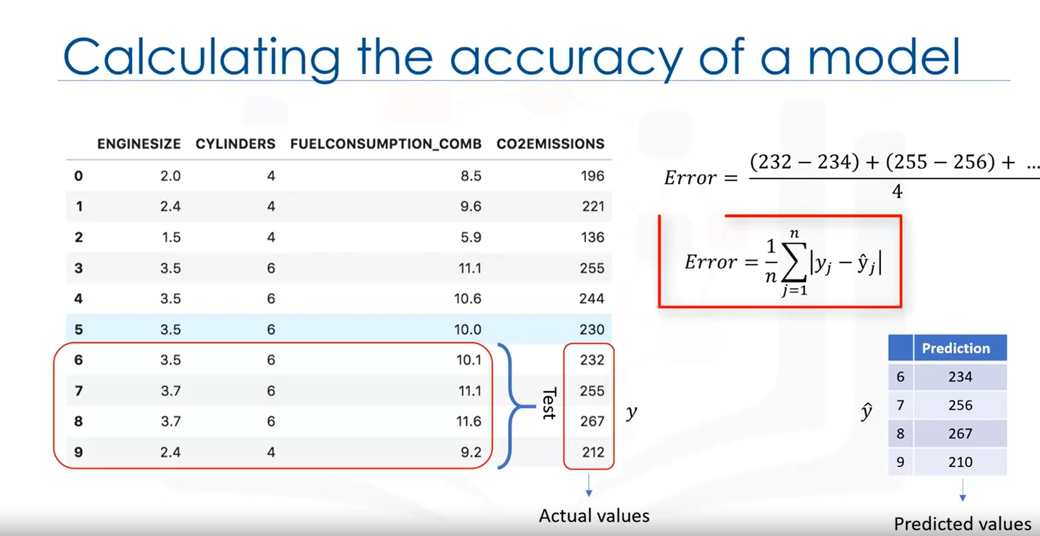

Slide 28
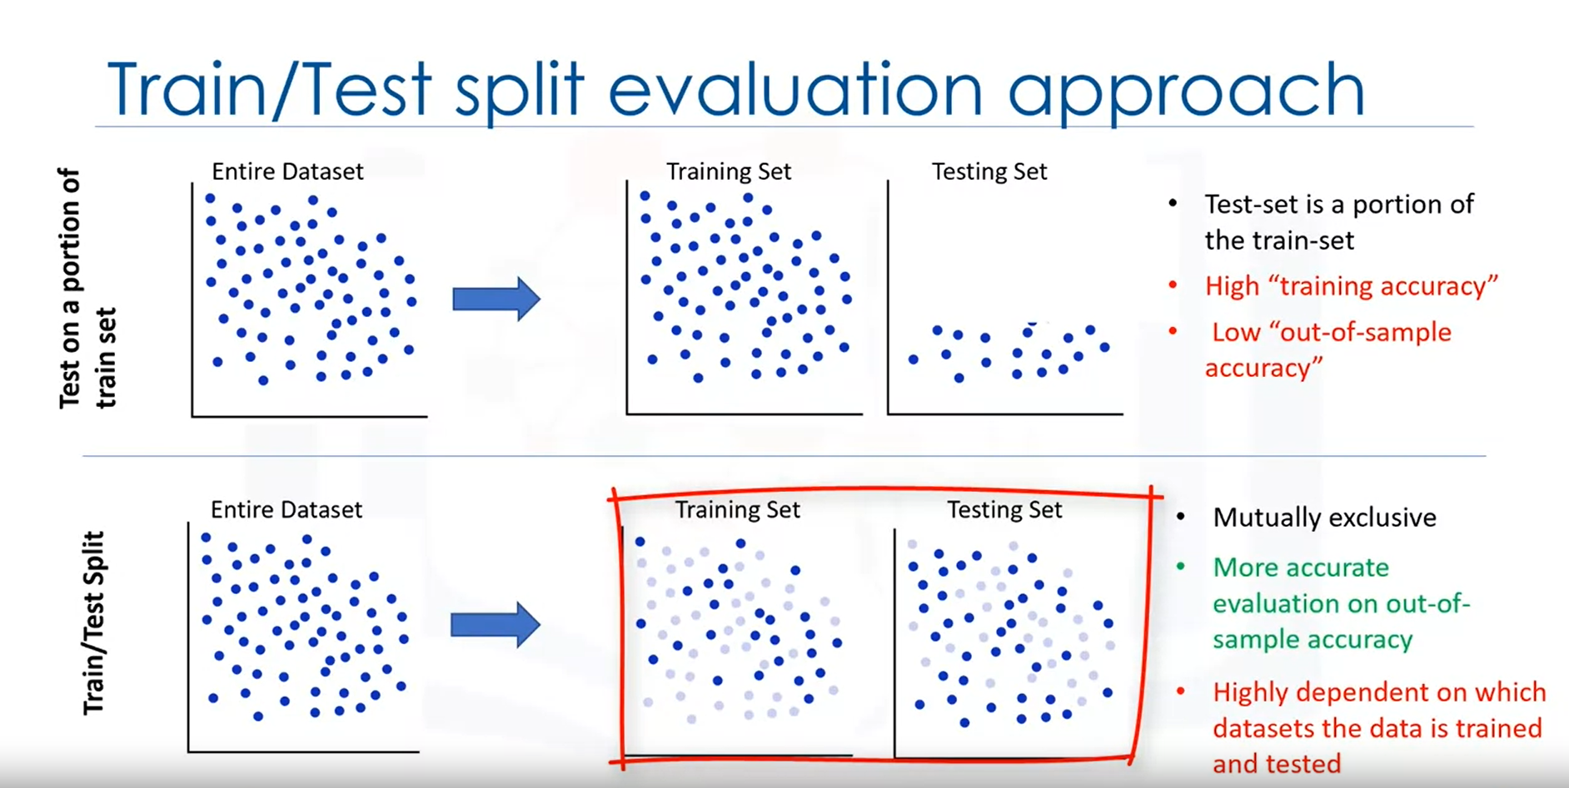

Slide 29
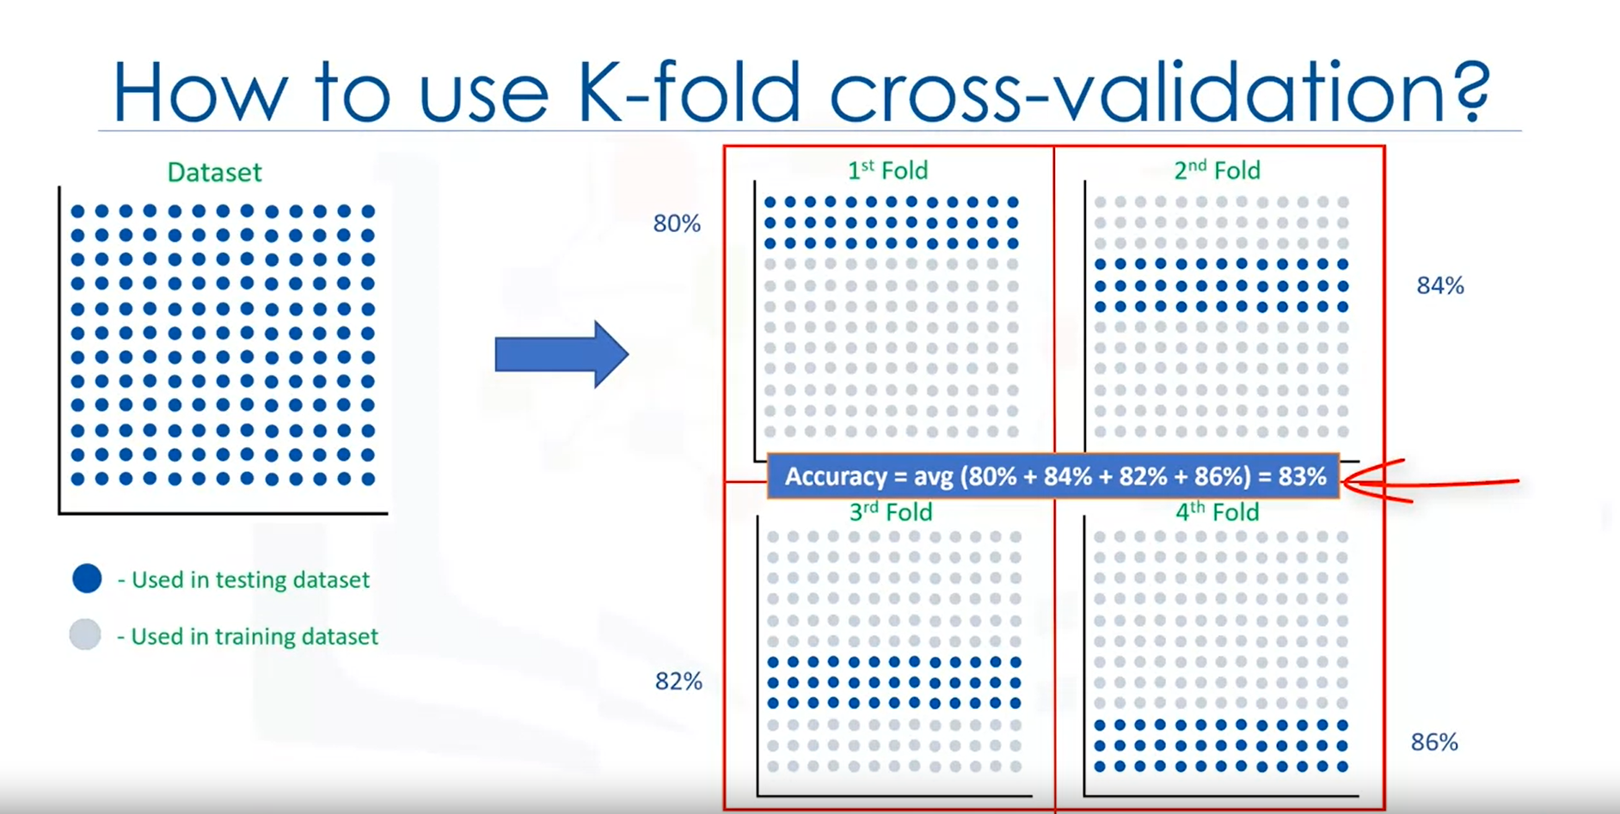

Slide 30
Model Evaluation in Regression
Evaluation Approaches
Train and test on the same dataset.
Pros and cons of this approach.
Training accuracy vs. out-of-sample accuracy.
Train/test split.
Benefits of using separate training and testing sets.
Real-world applicability and accuracy assessment.
Accuracy Metrics
Comparing predicted and actual values.
Calculating error using an equation.
Using metrics to measure model accuracy.
Importance of similarity between predicted and actual values.
K-Fold Cross-Validation
Addressing issues of dependency and variation.
Concept and process of K-fold cross-validation.
Averaging results for consistent out-of-sample accuracy.

Slide 31
Evaluation Metrics in Regression Models
Regression

Slide 32
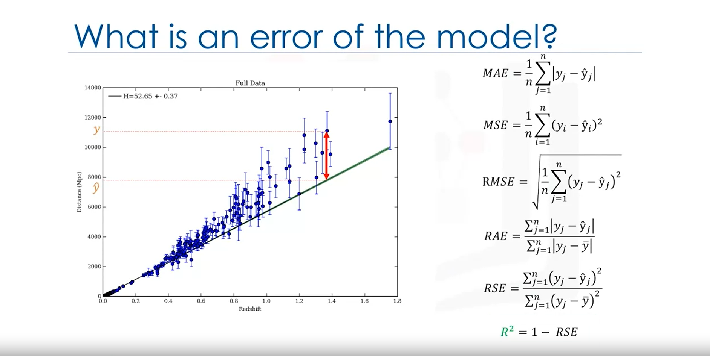

Slide 33
Evaluation Metrics in Regression Models
Mean Absolute Error (MAE)
Mean Squared Error (MSE)
Root Mean Squared Error (RMSE)
Relative Absolute Error (RAE)
Relative Squared Error (RSE)
R-squared

